Slide 1
Installing Miniconda3 on Windows 11

Slide 2
Installing Python 3.9 Version
https://repo.anaconda.com/miniconda/Miniconda3-py39_4.12.0-Windows-x86_64.exe
Running installer as admin from Cmd
Default install location is C:\ProgramData\Miniconda3 (a hidden folder)
Changing to C:\Program Files\Miniconda3 triggers warning due to space in "C:\Program Files"
Installing in C:\Miniconda3
Installing as secondary, refusing option to make Miniconda3 the "System" Python install (see next slide)

Slide 3
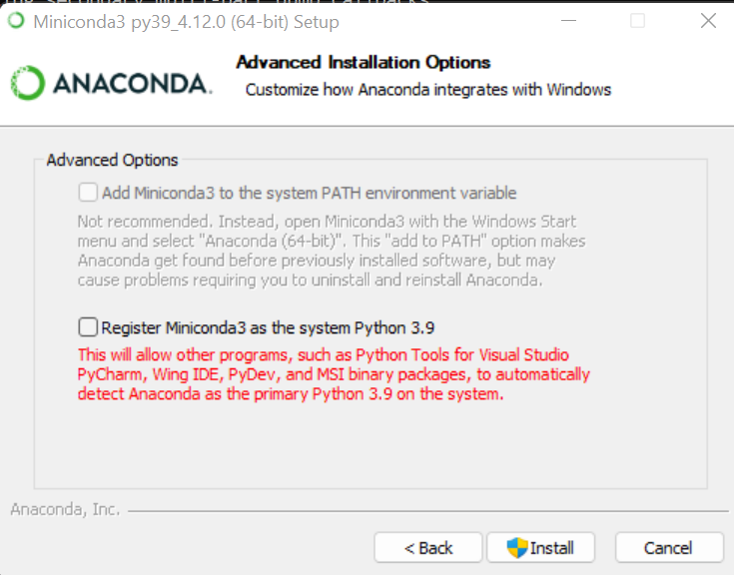
Do Not Set as Default System Python Installation
Leave unchecked

Slide 4
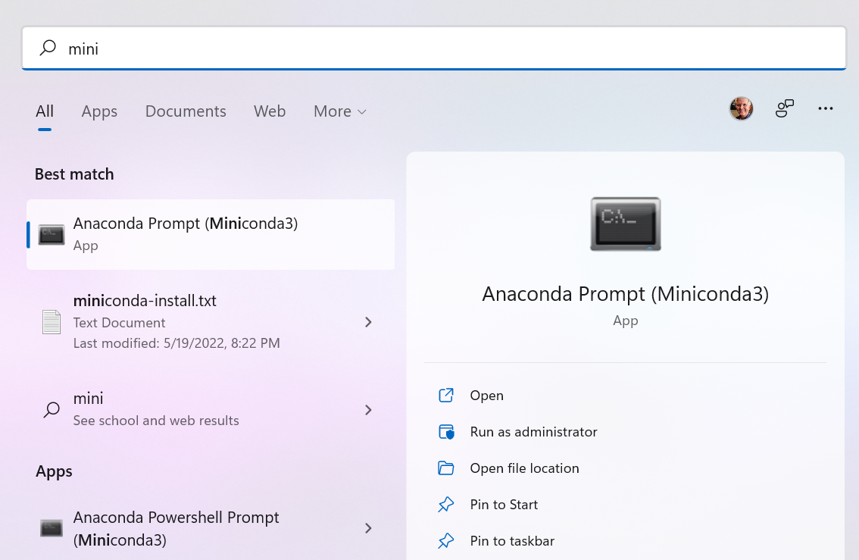
Starting conda (don't set PATH) as Normal User

Slide 5
Check conda Version and Python Versions
(base) C:\Users\daves>conda -V
conda 4.12.0
(base) C:\Users\daves>conda search "^python$"
Loading channels: done
# Name Version Build Channel
python 2.7.13 h1b6d89f_16 pkgs/main
…
python 3.10.4 hbb2ffb3_0 pkgs/main

